Slide 1
EV Charger
Manager
A Credo Hackathon Project
Farhan Ahmad, Hunter Broughton, Kevin Zhang, Supragya Seth

Slide 2

Problem
Unorganized EV charging system
Teams group chat (first come first serve)
Miscommunication
Overcharging / lingering
Chargepoint app: only shows occupied spots
Farhan Ahmad, Hunter Broughton, Kevin Zhang, Supragya Seth

Slide 3

Ideating
Asked current users for feedback
Meeting to discuss ideas & room for improvement
Reached out for Chargepoint API (awaiting)

Slide 4
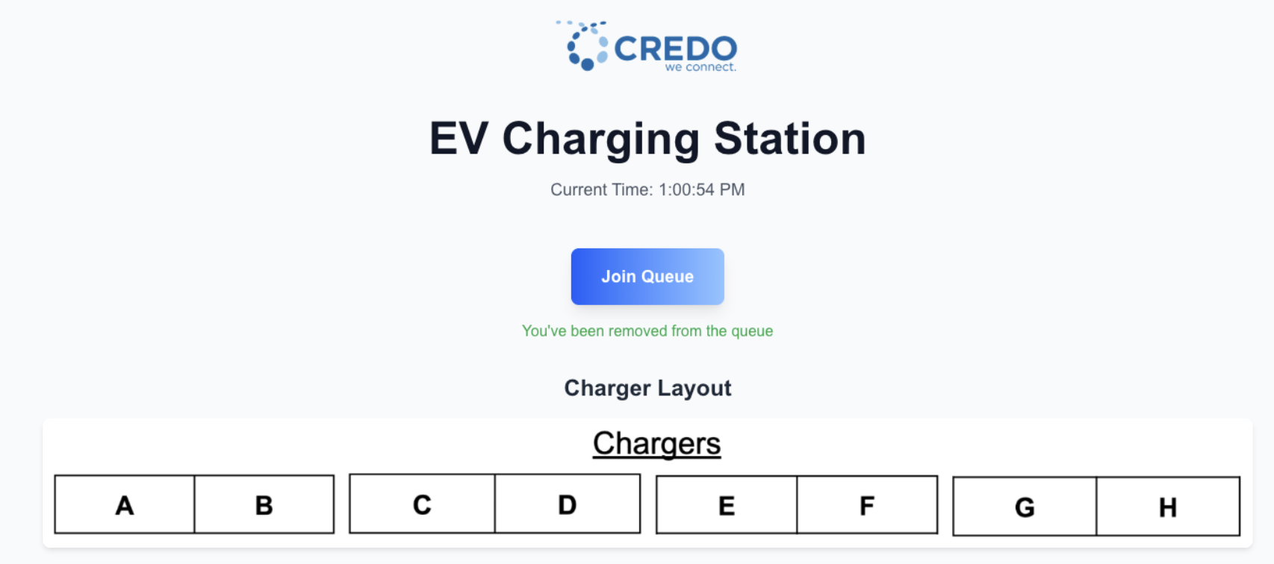
Solution
Management site
Clear tracking display
Queue system
Transparency
Automation
Chargepoint API (awaiting access)
Farhan Ahmad, Hunter Broughton, Kevin Zhang, Supragya Seth

Slide 5
EV Charger Manager
Next JS: API communication
React JS: front end
Tailwind CSS: user interface
Nodemailer: emailing provider
Bcrypt: password hashing
Vercel: deployment
SQLite, Prisma: Databases
Farhan Ahmad, Hunter Broughton, Kevin Zhang, Supragya Seth

Slide 6
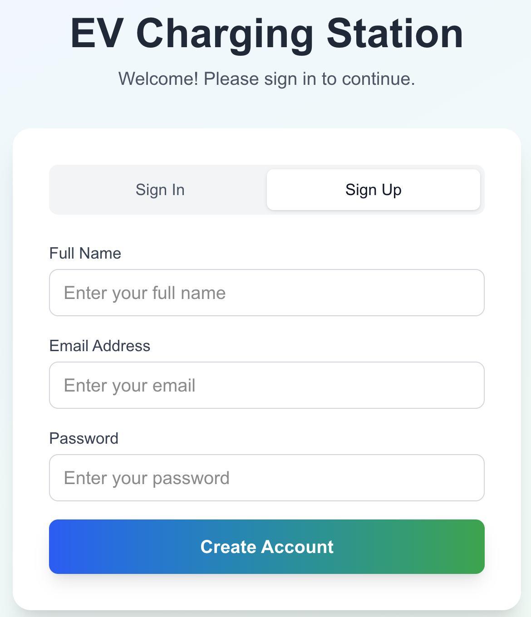
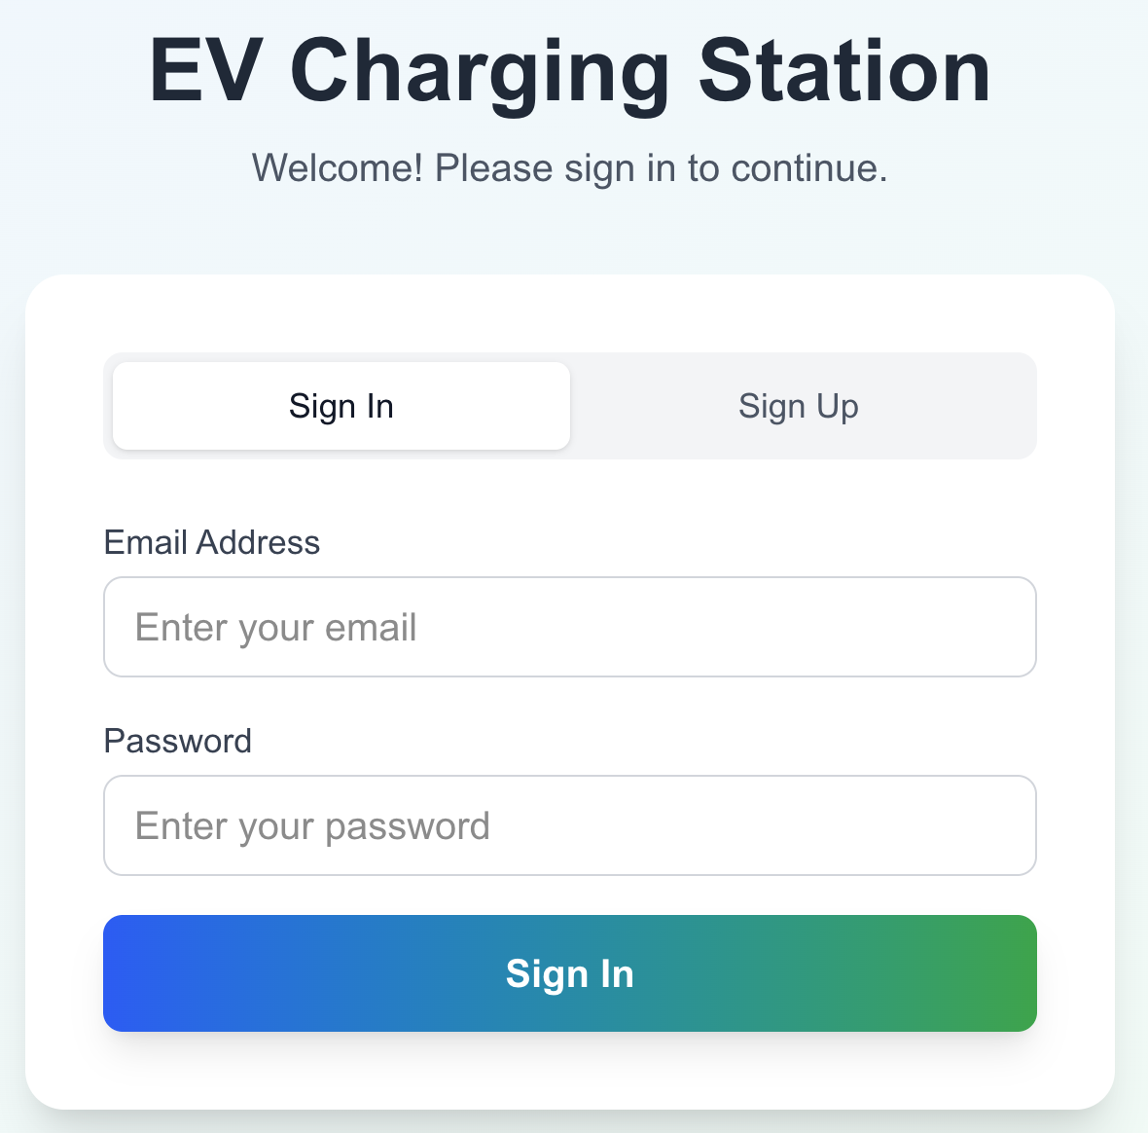
Farhan Ahmad, Hunter Broughton, Kevin Zhang, Supragya Seth

Slide 7
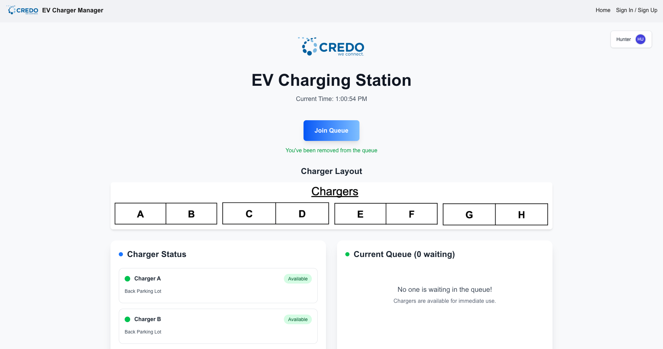
Farhan Ahmad, Hunter Broughton, Kevin Zhang, Supragya Seth

Slide 8
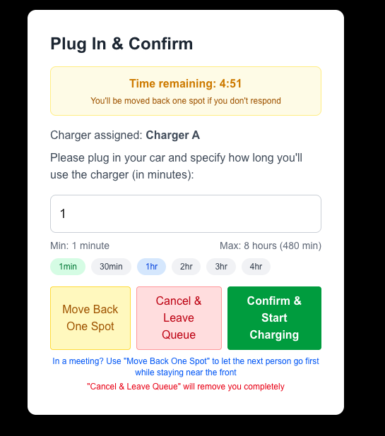
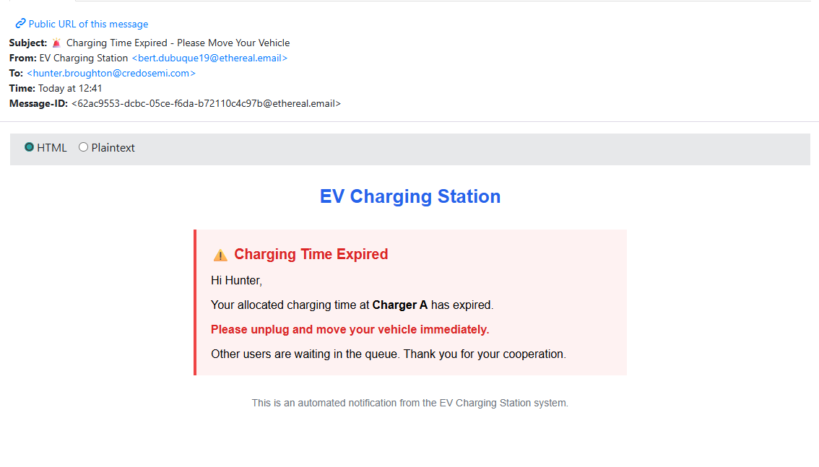
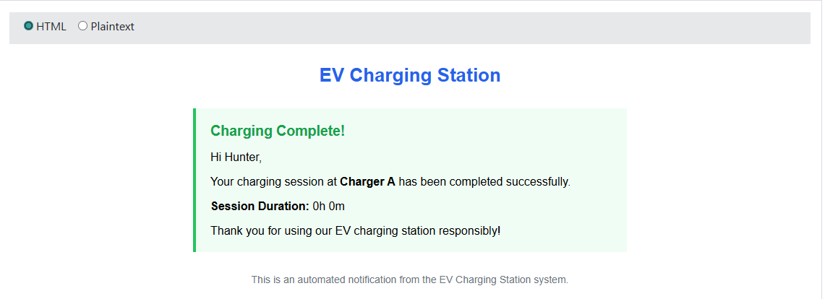
Farhan Ahmad, Hunter Broughton, Kevin Zhang, Supragya Seth

Slide 9
Live Demo
Farhan Ahmad, Hunter Broughton, Kevin Zhang, Supragya Seth

Slide 10
Company Name
Next steps
Integrate Chargepoint custom API
Automated tracking (minimize user input)
Deployment
Farhan Ahmad, Hunter Broughton, Kevin Zhang, Supragya Seth

Slide 11

Any questions?
Farhan Ahmad, Hunter Broughton, Kevin Zhang, Supragya Seth

